Slide 1
Experiment design

Slide 2
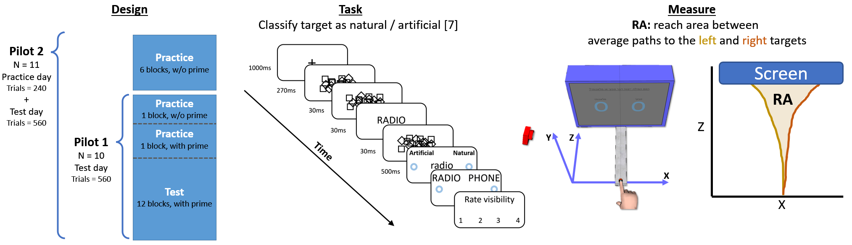
Experiment design
Onset time > 100 ms
Reaction time < 320 ms
Movement time < 420 ms

Slide 3
High volume of “bad” trials
Onset time > 100 ms
Reaction time < 320 ms
Movement time < 420 ms
Number of bad trials per subject
Pilot 2 Pilot 3

Slide 5
Normalization of Z means that the plots do not represent the actual trajectory.

Slide 6
Changes of mind.
How many COM trials do we have?
Look at your trajs and see what kind of criterion can apply.
Couldn’t find anything concise. They COM can happen on either half of the space (left / right) and can be early or late. You can have more than a single change of mind.
One prominent feature is the “point of maximum” (where the derivative is 0). This is how I recognize them when I look at the trials.

Slide 7
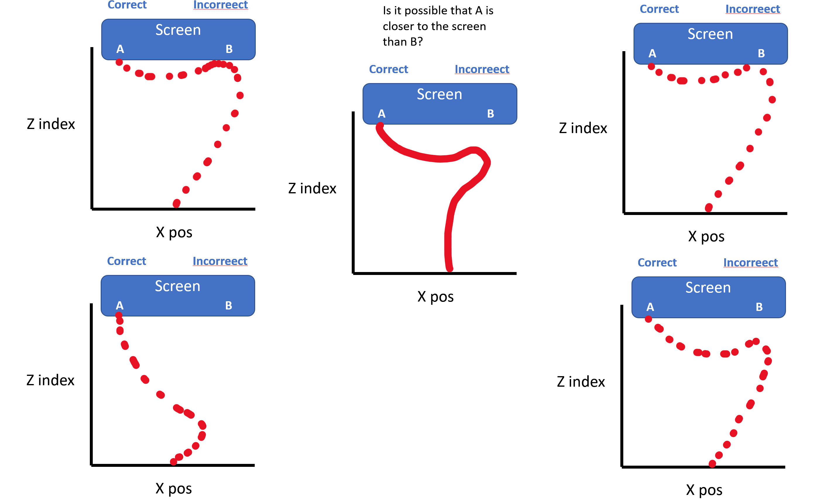
Changes of mind
Changes of mind Could occur at 4 timepoints:
Post hoc - A short delay after touching the screen.
On the fly - Immediately after touching the screen.
Prior - Just before touching the screen.
Early - Far from the screen.
Questions:
Caused by the prime?
Usually regarded as: “Slow movement”, “Incorrect answer”
What is the difference between these 1-3?
Should they be treated differently?
Is (1) generated by a different motor plan?
Can 1 and 2 be differentiated with a “hover threshold”
(Schmidt, T. (2002))?
Possible to have multiple changes of mind in one reach.
Use number of COM as a measure?
1) 2)
3) 4)
Notes:
Caused by the prime?
If so, we are loosing the effect of the prime, since we discard these trails due to slow movement or incorrect answer.

Slide 8
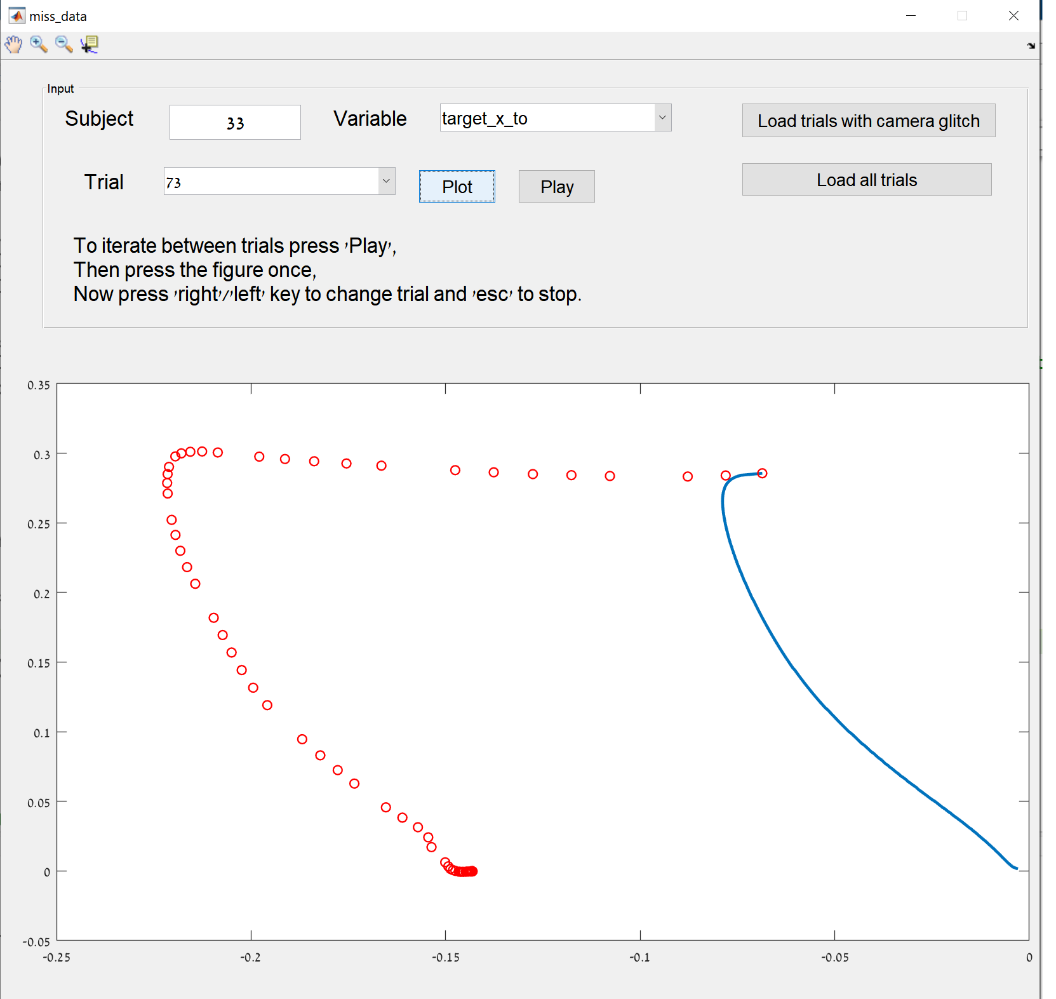
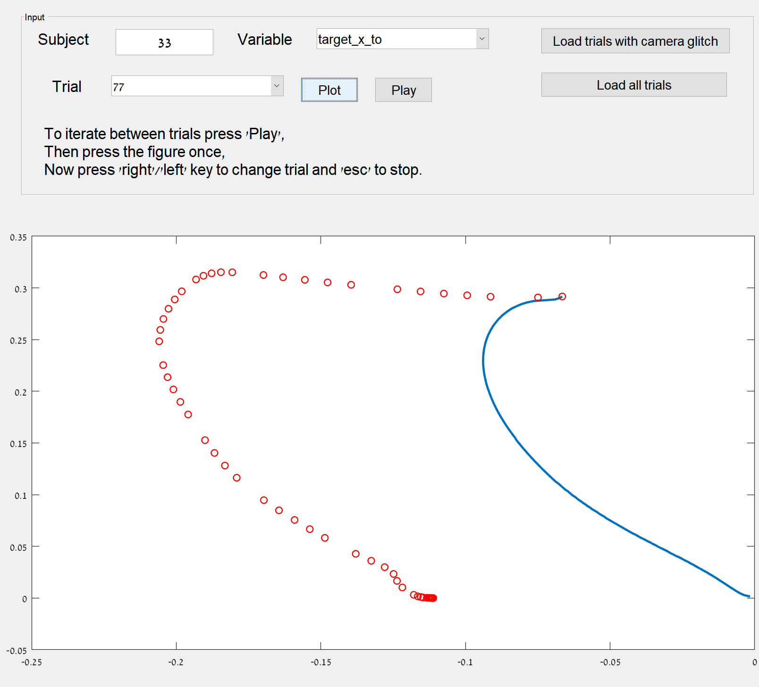
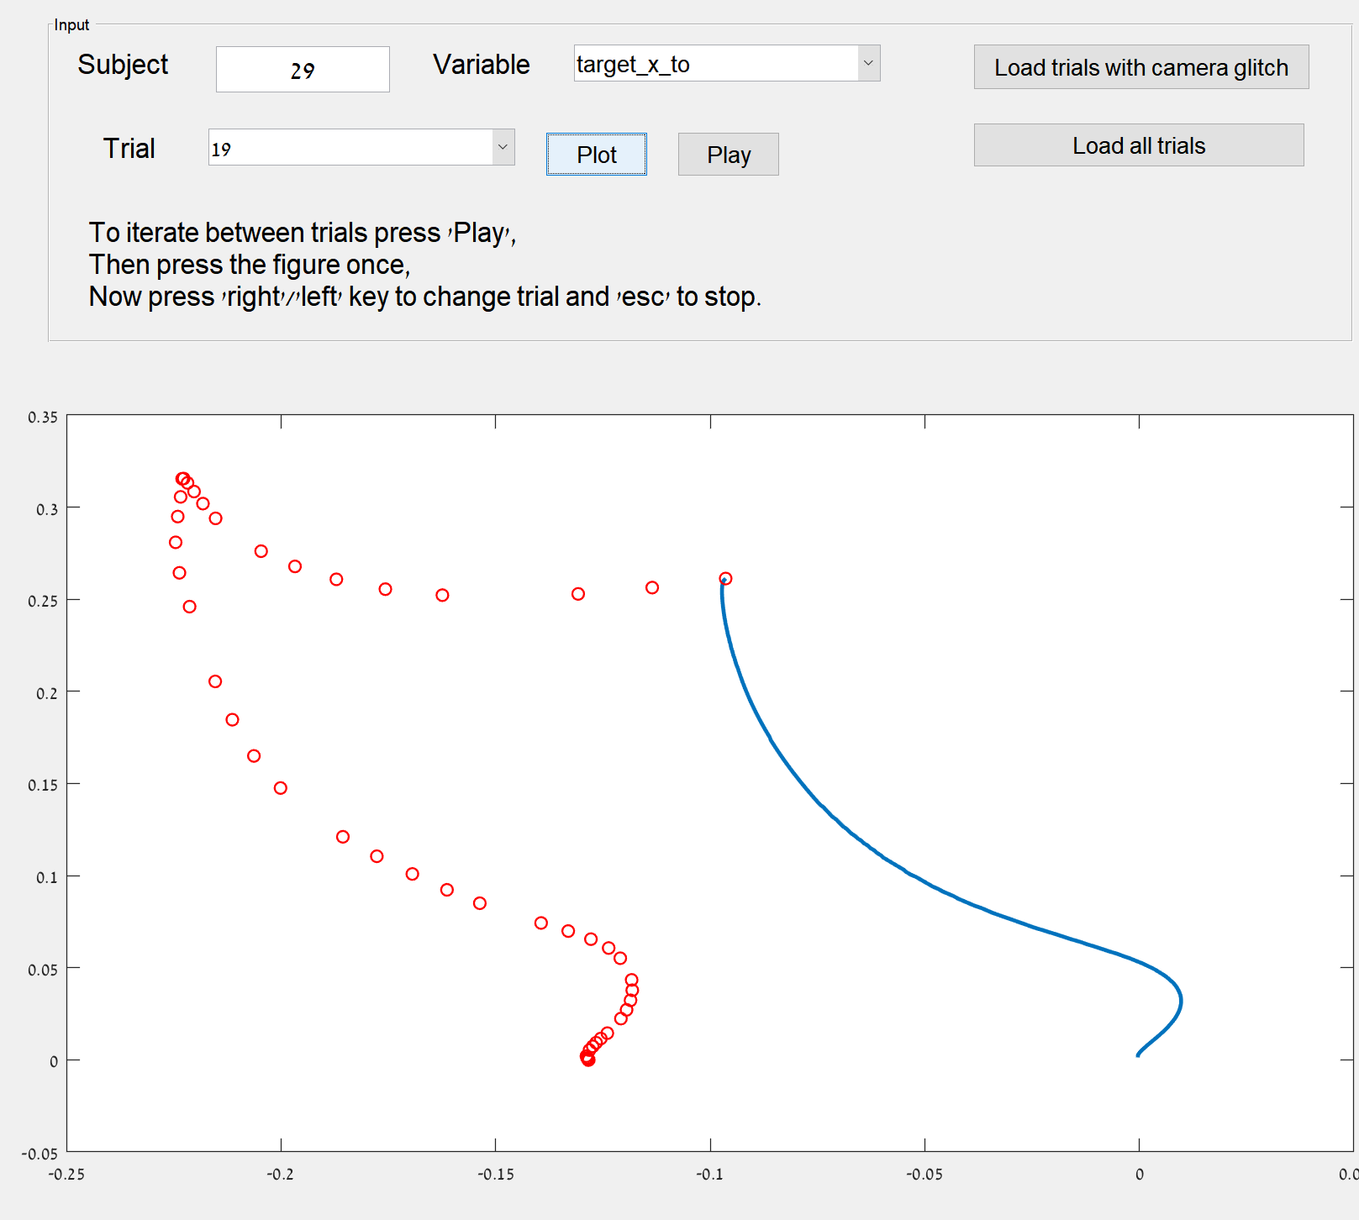
Changes of mind
Some changes of mind are discarded due to “slow movement”.

Slide 9
Changes of mind
Number of incorrect trials, some of which might qualify as changes of mind.
Percent of “Incorrect” trials out of valid trials:
Pilot 3 – 26%
Pilot 2 – 20%
(An incorrect trial cannot have any other reason for disqualification)
Pilot 2
Pilot 3

Slide 10
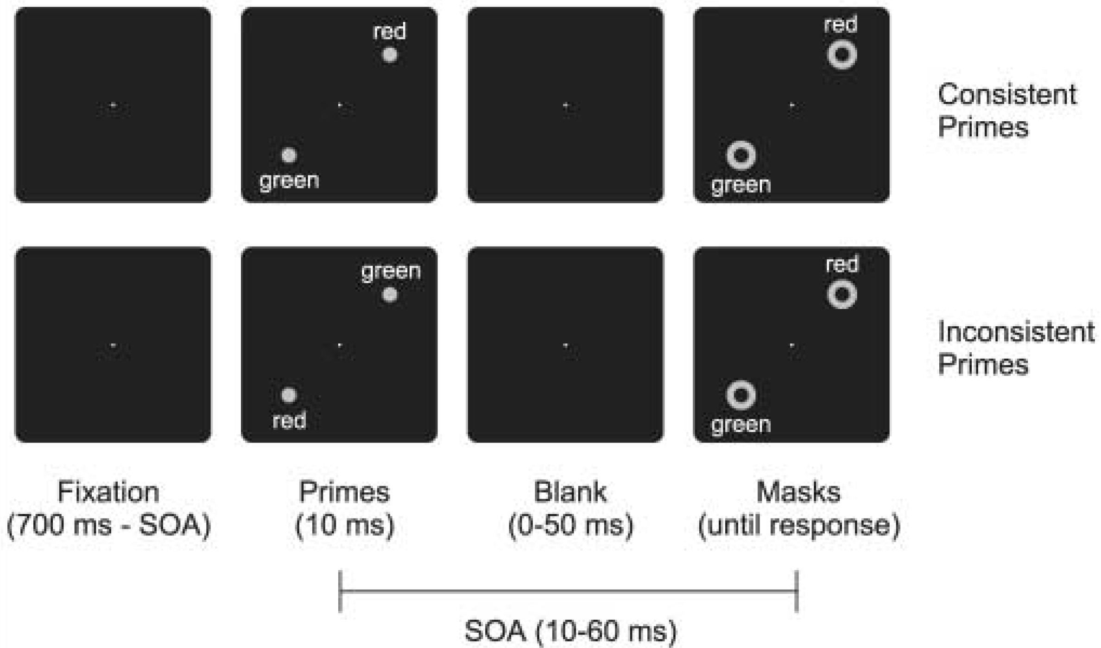
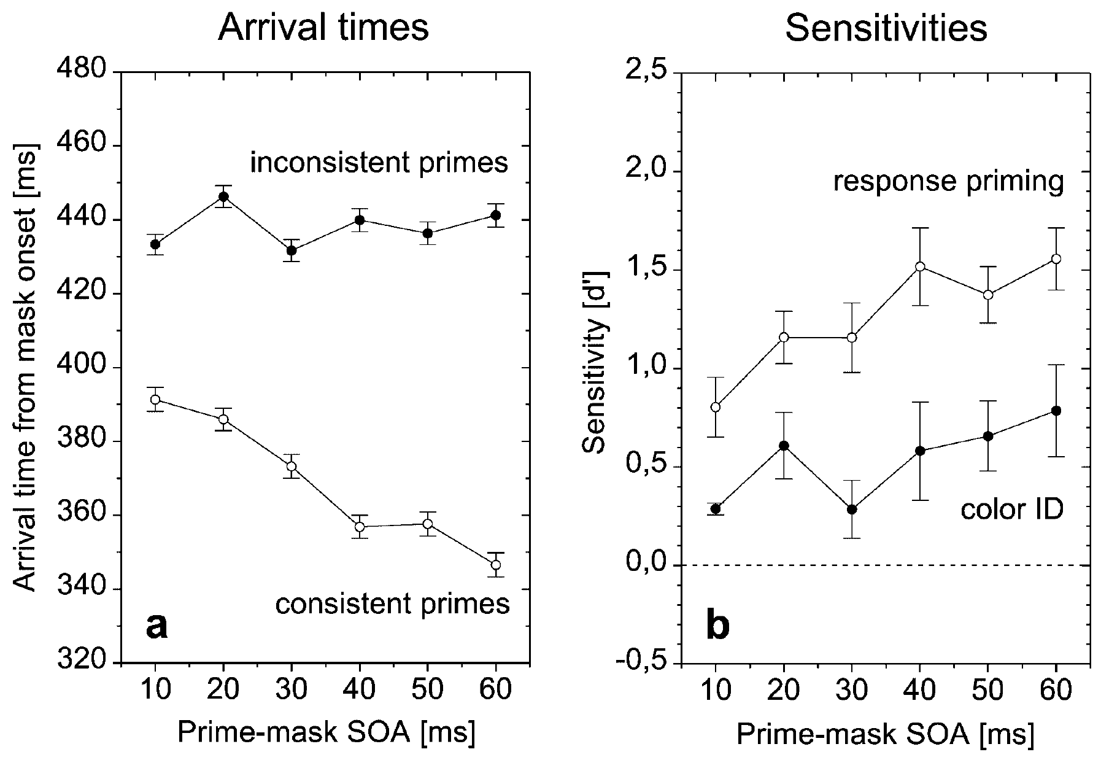
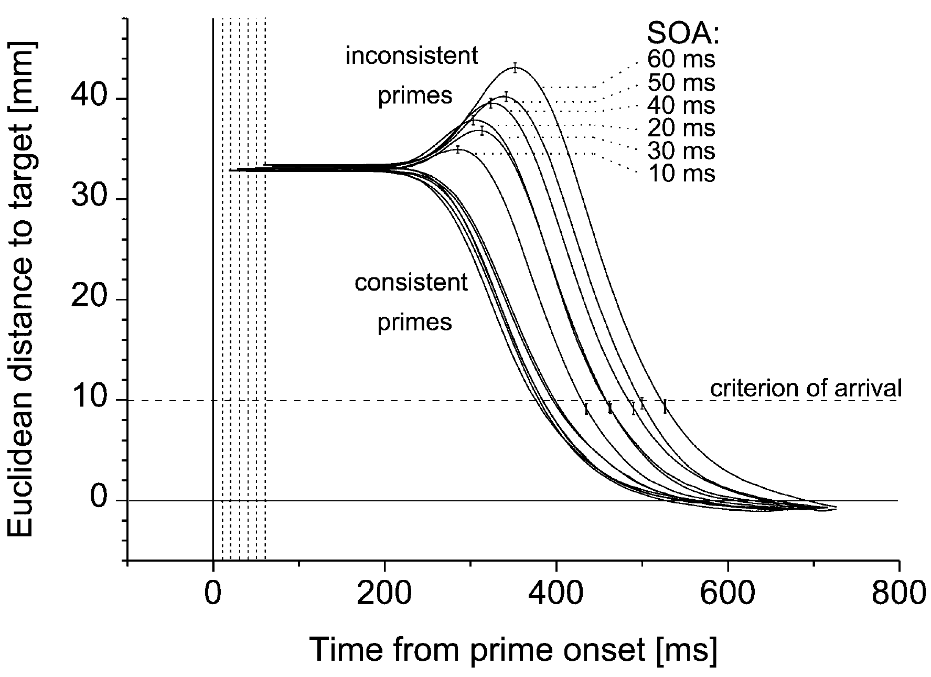
Schmidt, T. (2002) Exp 1
Tasks:
Mask ID – point to the red/green mask.
Response priming.
Color ID – point to the mask
preceded by a red/green prime.
Prime awareness.
“Hover threshold” = 334ms

